Slide 1


SECURE SOFTWARE DEVELOPMENT (SSD)
Diploma in CSF
Academic Year (AY) 20/21 – Semester 3 (April `20)
Week 16
Learning guidance
Last Updated: 13/07/2020

Slide 2
Contents
Gentle Reminder – SSD Quiz II
Learning Guidance for Week 16

Slide 3
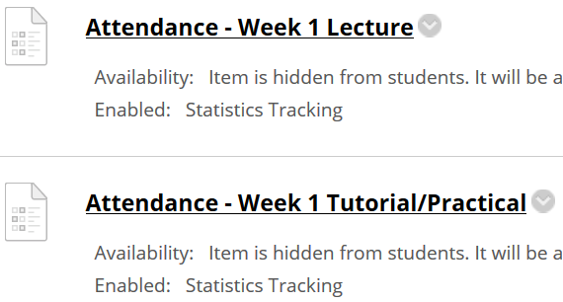
Important Details
VERY IMPORTANT
Visit MEL to start each week’s lesson. Learning materials will ONLY be released in MEL
Attendance Poll Attempt TWO attendance polls every week Starts Monday (9am) till Friday (11:59pm) Attendance :– Week x Lecture ( x refers to week number) Week x Tutorial/Practical Just click “Save and Submit”
Always lookout for announcements Do keep abreast of announcements in MEL
In light of the Covid-19 situation, your cooperation in adhering to the points mentioned is much needed and greatly appreciated.

Slide 4
Learning Guidance for Week 16
Notes
No new concepts in week 16 because week 13 slides (Secure Testing) span across week 15 & 16.
However, the following are guidance for students to conduct learning in Week 16.
Step 1 (Revise Week 11,12 and 13 slides)
In view of practical test this week, students are encouraged to revise Week 11, 12 and 13 lessons.
Step 2 (Complete SSD Assignment)
Students to complete and submit SSD Assignment by end of Week 16.
SSD Assignment submission in MEL (week 16 folder)
Step 3 (Presentation Demo in Week 17)
Please note that students to present and demo your assignment to your tutors in Week 17 & 18.

Slide 5
SSD Quiz II
Please note that SSD Quiz II will be conducted on Week 17.
Details as follow:-
Date: 13th Aug 2020 (Thursday)
Time: 4pm-5:30pm
Venue: SSD-AY2021-ALL-TEAM (Microsoft Teams)
Scope: Secure Coding & Secure Testing

